Slide 1
Java EE – An Introduction to Java Enterprise Edition

Slide 2
Agenda
What is Java EE?
Why Java EE?
Java EE
  Deliverables (what and why?)‏
  Basic Architecture
  Components and Containers
  Roles
  Lifecycle

Slide 3
Overview
A collection of enterprise technologies
Provides a component based approach to the design, development, assembly and deployment of enterprise applications
Enables solutions for developing, deploying and managing n-tier server-centric enterprise applications
An open industry standard (initiative led by Sun Microsystems(now Oracle))‏

Slide 4
Mission
To provide a platform-independent, portable, multi-user, secure, and standard enterprise-class platform for server side deployments written in the Java Language
Implement a standardized execution environment for distributed enterprise applications

Slide 5
The Java Platform
Hand-held devices
Workgroup Servers
High-end Servers
Desktop
Micro Edition
(Java ME)‏
Enterprise Edition
(Java EE)
Standard Edition
(Java SE)‏

Slide 6

Java EE Bundle
APIs and technology specification
  A collection / integration of various enterprise APIs
Development and Deployment platform
  A unified platform for server-side development
Reference Implementation
  Implements the Java EE specification & demonstrates its viability
Compatibility tests
  Certifies a Java EE product, confirms application portability
Java EE Blueprints
  Programming model, patterns, guidelines, best practices

Slide 7
Why Java EE?
Platform value for developers
  Can use any Java EE implementation for development and deployment
  Vast amount of Java EE community resources
  Can use off-the-shelf 3rd party components

Slide 8
Why Java EE?
Platform value to vendors
Vendors work together on specifications and then compete in implementations
  In the areas of Scalability, Performance, Reliability, and so on
Freedom to innovate while maintaining the portability of applications

Slide 9
Why Java EE?
Platform value to Business customers
Application portability
Many implementation choices are possible based on various requirements
  Price (free to high-end), scalability (single CPU to clustered model), reliability, performance, tools & more
Best of breed of applications and platforms
Large developer pool

Slide 10
Evolution of Distributed Transactional Computing
Overview of technologies leading to distributed computing
  1 tier, 2 tier, 3 tier, n tier architecture
Application Servers
  Proprietary
  Open standard

Slide 11




N-tier J2EE Architecture
EJB Application Server
RMI-IIOP
Container
HTTP (JSP/Servlets)‏
Web Server

Slide 12
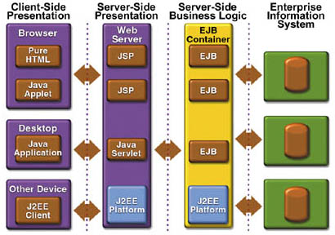
Java EE Architecture – Tiers and Components View
Client Tier Web Tier Business Tier Data Tier

Slide 13
Java EE Server and Containers
Java EE Server
Web Container
Web Browser
Servlet
JSP Page
Database
Application
Client
Container
Application
Client
EJB Container
Enterprise
Bean
Enterprise
Bean
Client

Slide 14
Java EE Components
The Java EE platform uses a multi-tiered distributed application model
The Java EE application components parts comprise:
  Client-tier components (run on the client machine).
  Web-tier components (run on the Java EE server).
  Business-tier components (run on the Java EE server).
  Enterprise information system (EIS)-tier software (runs on the EIS server).
Essentially considered to be three-tiered application, because of being distributed over client, J2EE server and the database.

Slide 15
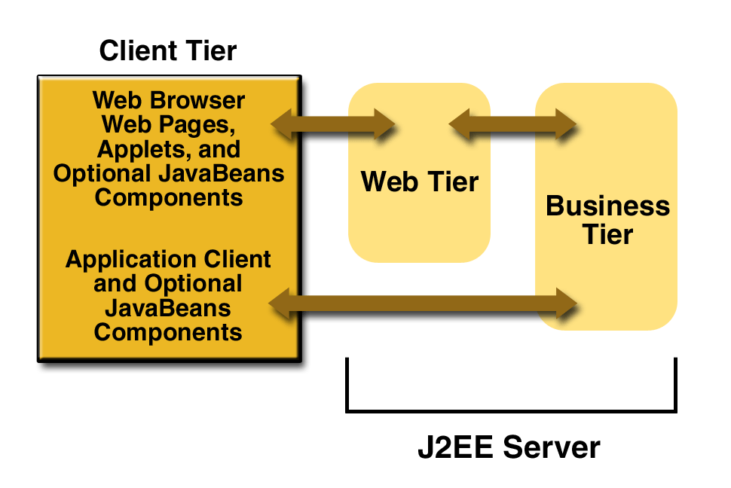
Java EE Components: Client Tier
Client
  Web clients (web-browser, web pages, applets)‏
  Application client (application user interface built using Swing or AWT, or a command line interface)‏
  CORBA IIOP complaint clients

Slide 16
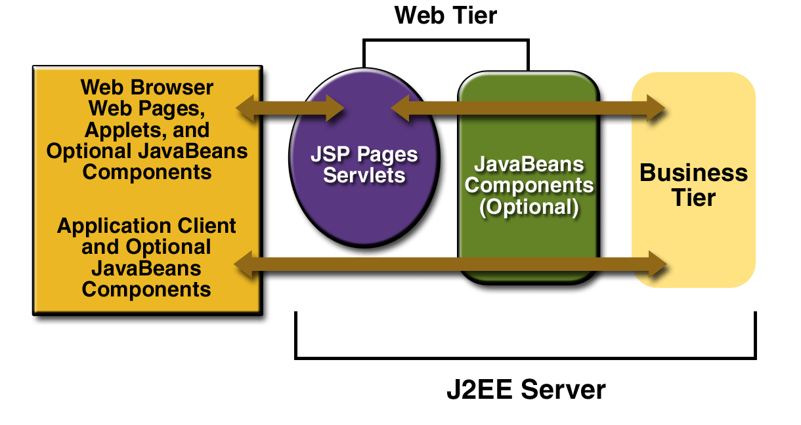
Java EE Components: Web-tier
Web components
  Servlets or JSP pages
  Java Beans (optional)‏

Slide 17
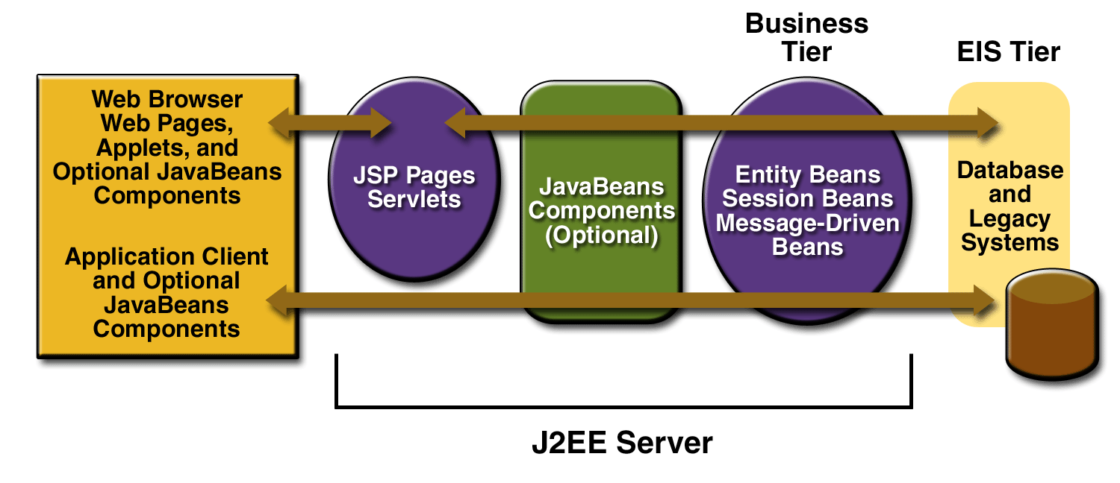
Java EE Components: Business tier
Business Components
  Enterprise Beans handle the application logic
    Separates business process (session beans) and data component (entity beans)‏
  Applications requiring messaging facility use JMS

Slide 18
Java EE Components: Data tier
Application Database Server
  Any relational database (eg Oracle, MS SQL, etc)‏
Enterprise Information System (EIS)‏
  Includes enterprise systems like ERP, mainframe transaction processing, database systems and other legacy information systems
  J2EE applications often rely on this tier to store the enterprise’s business critical data

Slide 19
Container Services
Security
Transaction Management
Naming and directory
Remote connectivity
Lifecycle management
Persistence
Concurrency
Resource Pooling

Slide 20
Container Types
The deployment process installs Java EE application components in the Java EE containers
  EJB container
  Web container
  Application client container / Applet container
The Java EE server provides EJB and Web containers and is the operating run-time environment

Slide 21
Java EE Technologies
Component Technology
  Applet, application clients, Enterprise beans, web components (JSP / Servlets)‏
Service Technology
  JDBC, JNDI, JTS, Connector Architecture, Web Services etc
Communication Technology
  RMI-IIOP
  Internet protocols (HTTP, SSL, TCP/IP)‏
  Messaging (JMS, Java Mail)‏

Slide 22
Java EE APIs (Bundled)‏
Java SE
  Java SDK
    Java Standard APIs
Java EE
  Enterprise JavaBeans (EJB)‏
    - Aritecture for building server-side components
  Java Remote Method Invocation (RMI) & RMI-IIOP
    - Method invocation across Java virtual machines. Can also integrate with other clients comfirming CORBA IIOP specification
  Java Naming and Directory Interface (JNDI)‏
    - Naming service for locating resources over the network
  Java Database Connectivity (JDBC)‏
    - Java interface to relational database
  Java Servlets & Java Server Pages (JSP)‏
    - Technology allowing dymanic web content generation
  Java Activation Framework (JAF)‏
  J2EE Connector Architecture

Slide 23
Java EE APIs (Bundled) contd …
Java Messaging Service (JMS)‏
  Enables asynchronous communication, including point-to-point and publish/subscribe messing
Java IDL
  Java technology based CORBA ORB implementing a subset of CORBA specification
Java Mail
  Mailing APIs
Java API for XML Parsing (JAXP)‏
  XML parsing and manipulation. Used to describe EJB components, file scripts
Java Transaction API (JTA) and Java Transaction Service (JTS)‏
  Used to manage transactions
Java Authentication and Authorization Service (JAAS)‏
  Security services API
Others (performance specific, not mandated by the specification)‏
  Load balancing, data caching, transparent fail over, etc

Slide 24
Java EE Application Assembly and Deployment
Applications are packaged into one or more standard units for deployment to any Java EE platform-compliant system
Each unit contains
- a functional component or components (enterprise bean, JSP page, servlet, applet, etc.),
- a standard deployment descriptor that describes its content,
- J2EE declarations which have been specified by the application developer and assembler.
Once the unit is produced, is ready for deployment

Slide 25
Deployment
Descriptors (XML Files)‏
Java EE Unit (war, jar or ear)‏
Deployment
Tool
EJB
JSP
Deploy
Servlet
J2EE Server
HTML

Slide 26
Java EE Roles
Java EE product provider
  One who designs and makes available the Java EE platform, APIs and other features defined in the Java EE specification
Component Provider
  One who provides web components, enterprise beans, applets or application clients for use in J2EE applications.
Application Assembler
  One who gets the components and assembles it into an application

Slide 27
Java EE Roles (continued…)‏
Application Deplorer and Administrator
  One who configures and deploys the J2EE application, administers and monitors the deployment
Tool provider
  One who creates development, assembly and packaging tools used by component providers, assemblers and deplorers

Slide 28
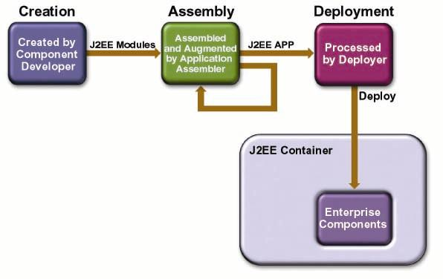
Java EE Lifecycle

Slide 29
Java EE Application Anatomies
4-tier Java EE applications
  HTML client, JSP/Servlets, EJB, JDBC/Connector
3-tier Java EE applications
  HTML client, JSP/Servlets, JDBC
3-tier Java EE applications
  EJB standalone applications, EJB, JDBC/Connector
B2B Enterprise applications
  Java EE platform to Java EE platform through the exchange of JMS or XML-based message

Slide 30
References
Java EE Tutorial, Sun Microsystems (now Oracle)
Simplified guide to the Java EE Platform, Enterprise Edition, Sun Microsystems (now Oracle)
Sun TechDays Conference 2000-2001 slides,
  Sun Microsystems
Mastering Enterprise JavaBeans, 3rd Edition
  By Ed Roman

